Slide 1
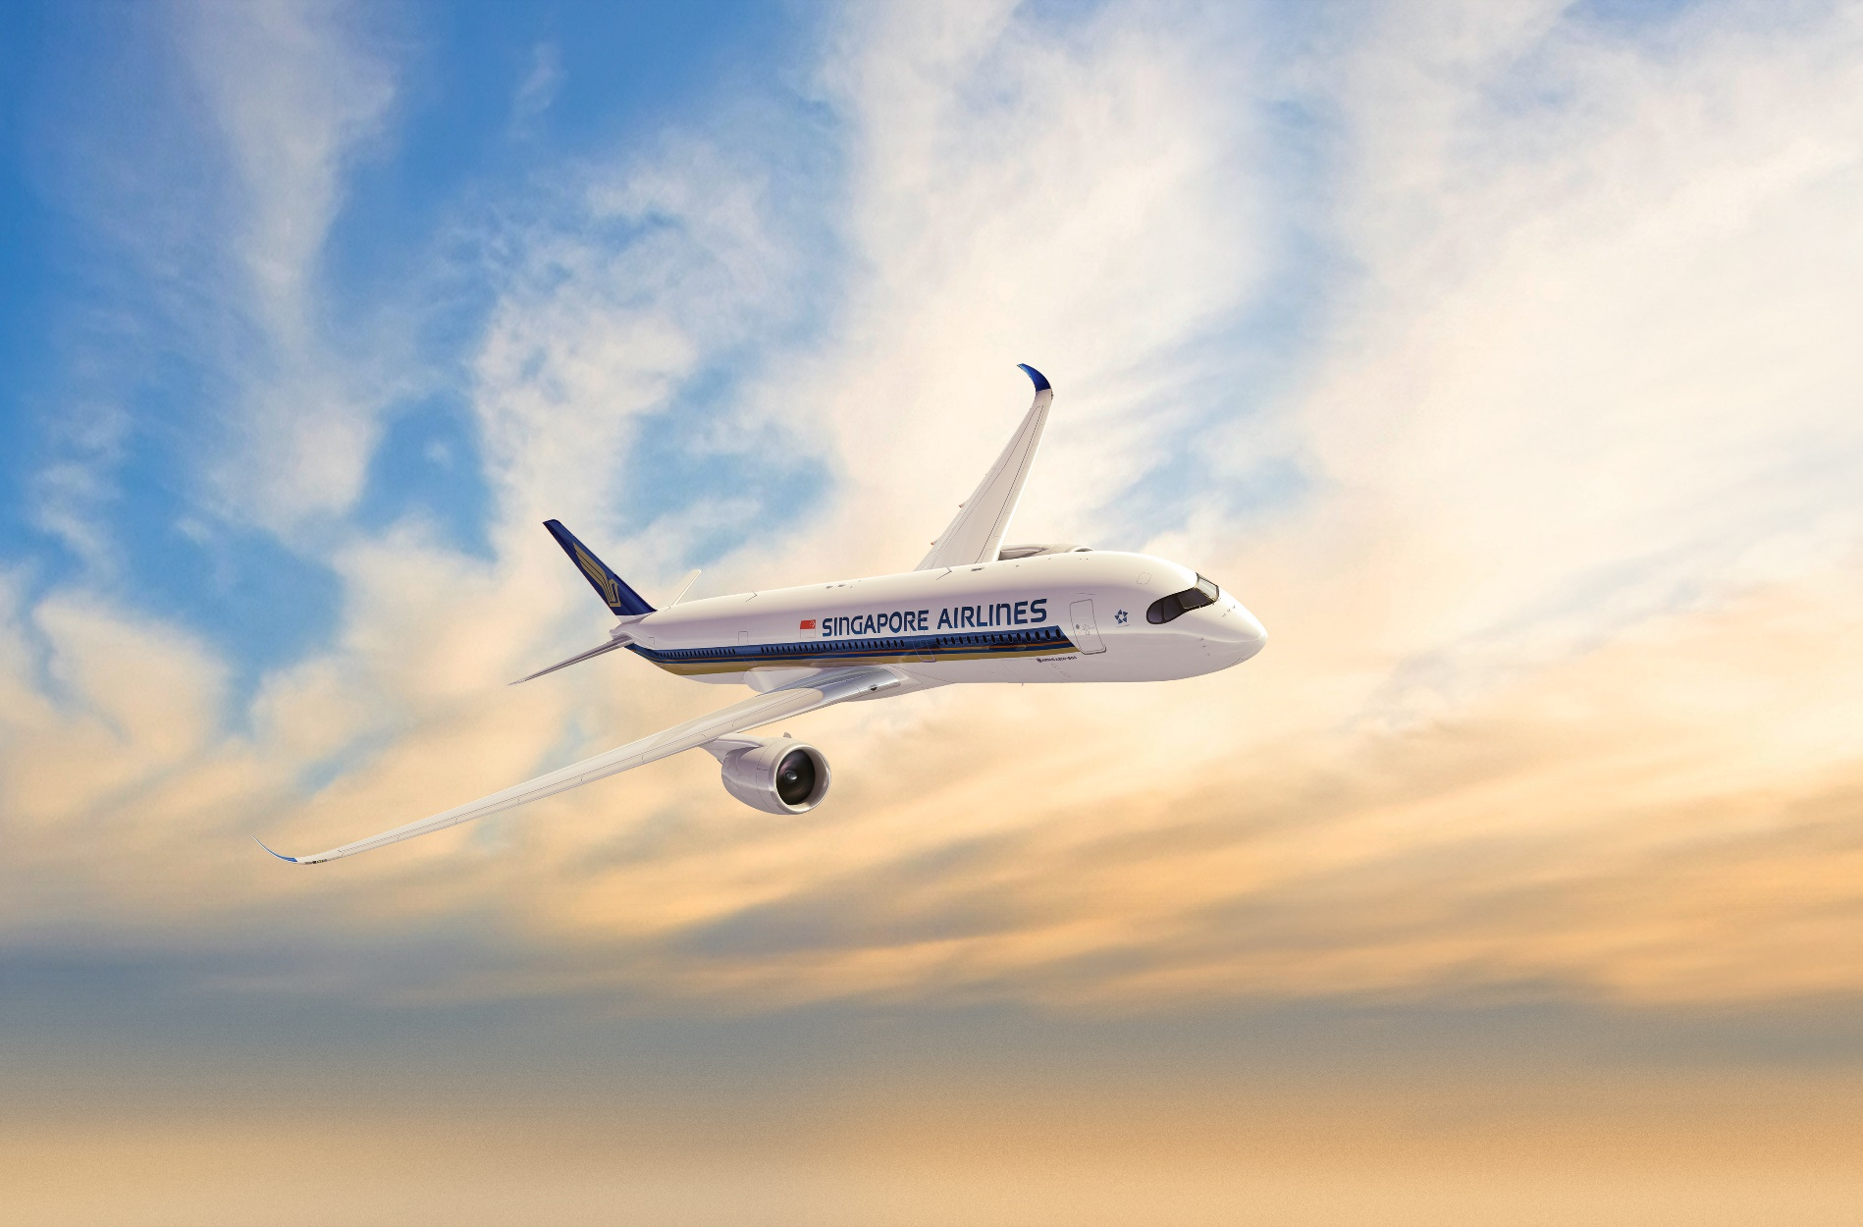


LOCATION
BASED
GROUND
TOUR
APP CHALLENGE 2019
ROARING WHALE

Slide 2

Location Based Ground Tour
Make Air Interesting Again
Make Air Interesting Again
Watching from Sky
Interacting from Sky
Experiencing from Sky
Watching from Sky
Interacting from Sky
Experiencing from Sky

Slide 3





Team Introduction
Roaring
Whale
Startup Company
in Shenzhen, China
We are
Programmers, Trekkers, Explorers
We are
Experts in the fields of
AR IOTA SLAM LBG
David
Alex
Nalon
Design + Program
Market + Design
Program

Slide 4
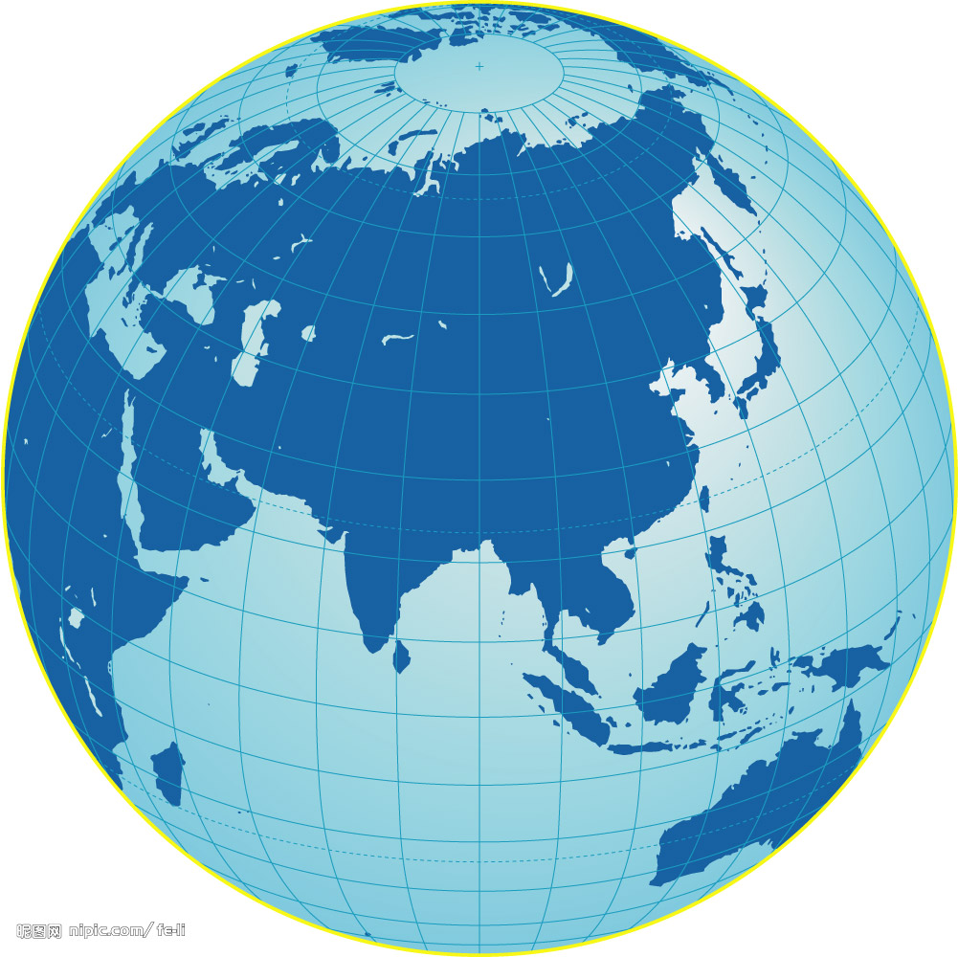

The Problem / Opportunity
Today people flying always, and tired of the services provided by plane.
Most of people are just SLEEPING during the whole trip :(
NEW SERVICE MUST BE CREATED
Why is it important?
How big is the problem?
Who does it affect?
People will choose an Airlines with better experiences besides price.
Commercial services could be accepted by people during the trip.
I have no accuracy statistic data about the percentage of passengers who are sleeping, but we all have seen the facts.
I am sleeping always, boring.
Plane is flying, Ground is changing. These dynamic information are interesting and never be boring if service based on them.
Every passengers will be involved in the service.

Slide 5

Research Findings
“
Referenced Statistics
I always fly by different Airlines,
but I feel BORING more and more.
https://www.jianshu.com/p/b34594f3b3df
Sleeping = 80%
Watching Pad = 10%
Chatting = 6%
Watching TV = 2%
Watching Magazine = 2%
Magazine, TV, Pad, Music …., but
I HAVE SEEN THEM TOO MANY TIMES
I like to site beside window, because I can watch the ground from sky.
Plane flying, Ground changing, that is AMAZING.
I do not known any such service has been provided by Airline Company.
That service may be attractive to other people, that means …. 80% passengers.
WHAT SHOULD THE IDEA BE

Slide 6


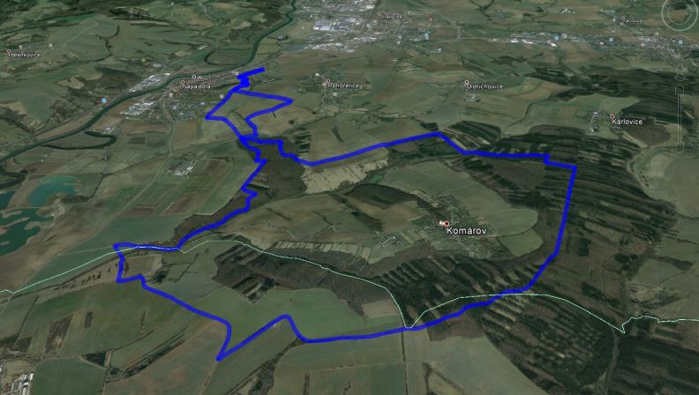
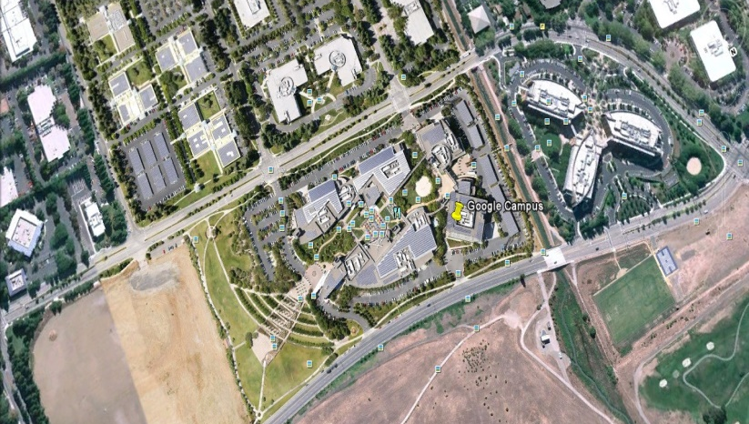
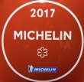
Scenario
Our Idea
Passengers can see and manipulate Ground View.
Ground View changes according to the location of plane.
Dynamic Information are layered onto the Ground view.
Passengers can interact with interesting information, or interact with other passengers, or play games
Nan Chi
French Style
40 Seats
$30 per person
Xiao Lu
Book Now
16 Km long, Grass covered
Diff.
4 Teams is calling members
Join Other Team
Arrange Private Tour

Slide 7







Our Technology
Cloud
Server
Third
Party
Gateway
Plane GPS
Plane Server
Pad
Screen
VR
Plane GPS data is strongly recommended.
Plane Server provides offline service during flying, in order to minimize network connection, and acceptable user reaction delay time. But during parking, Plane Server exchanges data between Plane Server and Cloud Server.
Passenger login by ID Card, Passport. But others can not see it to protect privacy.
Map
Service
Other
Services
Engine

Slide 8
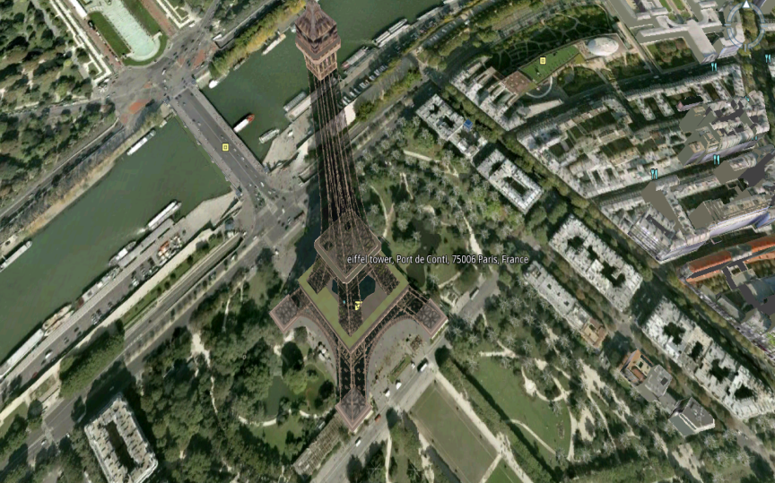


Demo
“
If a picture is worth a 1000 words, a prototype is worth a million slides
Yet we have not implemented the Demo
BUT ….
We have made lots of projects based on the same technology
We knew the key points, including design, develop and operation
Architect
Map Game
Service
Deploy
Maintain
Robust, Delay, Scale
Location, 3D
RTS, RPG
Hello ~
Partner, Revenue-Share
Engineering, Management
Customer, Quality

Slide 9
Business Value
What is your projected earnings, savings, and cost for your solution?
Business Model
Free
Pay
Play Game
Book Service
View

Slide 10
8. Business Value
What is your projected earnings, savings, and cost for your solution?
What other values can your solution bring to the table?
Direct Financial
Strategic
Operational
- Increased Revenue/ Increased number of users
- Cost Savings
- Reduced Asset Utilisation
- Applicability to other new ventures
- First Mover Advantages
- Pre-emptive strike against potential future threats
- Operational efficiencies achieved
- Potential for method to be propagated to other processes
- Eases bottlenecks/ reduces dependencies on other parties
Branding
Technological
Consumer/ Employee Satisfaction
- Increased happiness scores
- Reduced frictions/ waiting times
- Minimizes chances of adverse events
- Increased opportunities for publicity and marketing
- Novelty of solution strengthens existing branding or forges new images
- Development of key underlying technologies internally
- Adoption of better technology frameworks and practices

Slide 11
Project Plan & Next Steps
Share with us your roadmap
Timeline & Milestones:
List of future deliverables and targets for your prototype
Future Resources:
What resources would you need to implement your idea? Access to data and APIs?
Implementation Plan:
What is your proposed path to launch, what would be the implementation strategy? How will you test and trial your solution?

Slide 12

References
df595149790.github.com
www.dooyogame.com

Slide 13
10. References
Do you have more to share?
Share with us your Github project regarding your idea if you already have one
Any additional relevant documentation about your solution will be helpful
References to your past use cases would definitely boost your credibility
Give us your reference links <here>

Slide 14
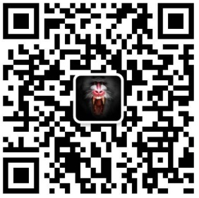
THANK YOU
David
DOOYO CEO
www.dooyogame.com

